Slide 1

Animation Scripting and Interactions

Slide 2
Learning Objectives
Understand the role of scripting in controlling animations.
Learn how to script interactive elements that respond to user input.
Gain hands-on experience in scripting animations and interactions.
Notes:
Online tutorial for this lesson:
https://www.youtube.com/watch?v=b0O2CRSdiOA&list=PLX2vGYjWbI0S-LEFR59E2B347w2HbjiJv
https://docs.unity3d.com/Manual/AnimationOverview.html

Slide 3
Animation Scripting Basics Recap
Animation Components in Unity:
Overview of Animation, Animator, and Animation Controller.
How these components work together to create animated sequences.
Animator Controller Setup:
Introduction to setting up Animator Controller for controlling animations.
States, Transitions, and Parameters: Explanation of their roles in managing animations.
Notes:
• Brief recap of fundamental animation scripting concepts covered in previous sessions.
• Reminder of the importance of scripting for dynamic and controlled movement.

Slide 4
Unity Animation System Integration
The process of "Animation System Integration" in Unity involves the seamless incorporation of animations into the game development workflow. This integration is achieved through various components and features provided by Unity's animation system.

Slide 5
Type of Unity Animation System Integration
Animator Controller: Unity's Animator Controller manages the flow of animations, states, and transitions for game objects. It allows designers to create complex animation states and transitions, controlling the playback of animations based on parameters, triggers, or script-based events.
Blend Trees and Layers: Blend Trees provide a way to smoothly transition between multiple animation states based on parameter values. Layers allow for combining different sets of animations, enabling complex blending and fine-tuning of animation behavior.
Animation Events: These are key points in an animation timeline where specific actions can be triggered. They are often used to synchronize animations with gameplay events or to call functions within scripts.

Slide 6
Type of Unity Animation System Integration
Scripting Integration: Unity allows developers to control animations using scripting languages like C#. This integration enables dynamic and interactive animations triggered by in-game events or user input.
Physics Integration: Animations can interact with physics in Unity. The integration of animations with physics components like Rigidbody or Colliders allows for realistic and responsive interactions between animated objects and the game environment.
Inverse Kinematics (IK): Unity's Animation System supports IK, enabsling precise control over character movements by manipulating specific bones or parts of a character while maintaining natural motion.
Animation Rigging: This feature allows developers to create procedural character animation using rigging tools and components, offering advanced control over character movement and deformation.

Slide 7
Scripting Animation Transitions
Scripting transitions between animation states involves programming logic to manage the flow between different animation states based on specific conditions or triggers. In Unity, this is commonly achieved using the Animator Controller and C# scripts..
For instance, imagine scripting a character's movement: when the player presses the forward key, the script sets a parameter in the Animator Controller to trigger a transition from the idle state to the walk state, initiating the walking animation. When the forward key is released, the script updates the parameter, transitioning back to the idle state smoothly.
Scripting transitions between animation states allows developers to create dynamic and responsive gameplay experiences where characters react to player input or game events through seamless animation changes.
Notes:
Slide 6,7,8,9 nói qua về các màn hình (windows) khi làm việc với animation

Slide 8
Scripting Animation Transitions
An outline of the process to intergate Scripting and Animation
Animator Controller Setup: Create an Animator Controller in Unity and define different animation states within it. These states represent various animations such as idle, walk, run, jump, etc. Set up transitions between these states using conditions, parameters, or triggers.
Scripting Transitions: Write C# scripts to control the Animator Controller's parameters or triggers. These scripts manage the transitions between animation states based on game events, user input, or other conditions.
Accessing Animator Component: Attach the C# script to the GameObject with the Animator component. This script will interact with the Animator Controller to trigger state changes.

Slide 9
Scripting Animation Transitions
An outline of the process to intergate Scripting and Animation
Defining Conditions: Within the script, define conditions that trigger state transitions. For example, if a player presses a certain key, the script can modify parameters in the Animator Controller to transition from the idle state to the walk state.
Updating Animator Parameters: Use methods like SetBool(), SetFloat(), SetInteger(), or SetTrigger() in your C# script to modify parameters or triggers in the Animator Controller. These changes cause transitions between animation states.
Testing and Refinement: Test the transitions in the Unity Editor, observing how the animations switch between states based on the conditions set in your scripts. Refine the transitions to ensure they're smooth and responsive.

Slide 10
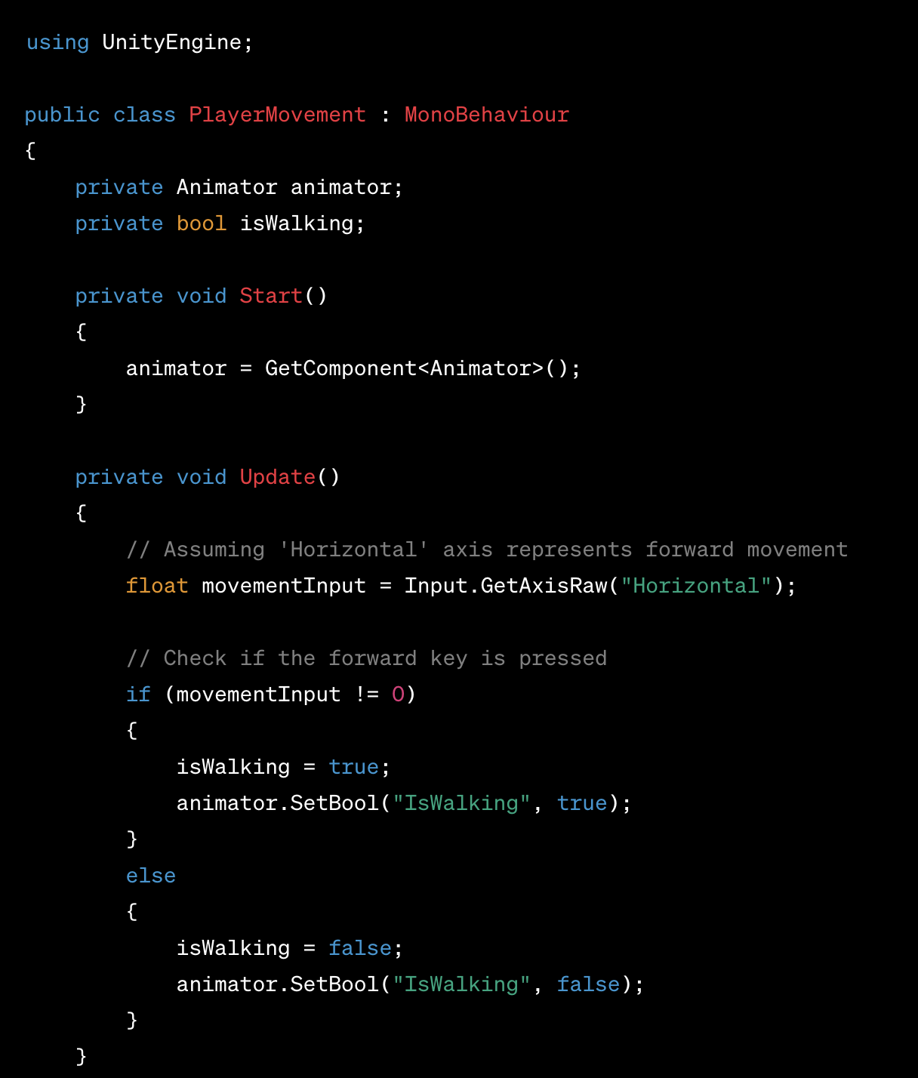
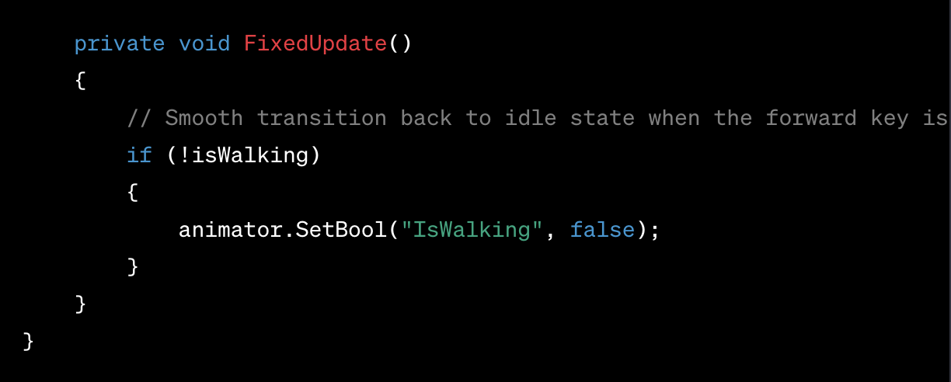
Scripting Animation Transitions
An example of Scripting Animation

Slide 11
Interactive UI Animations
Scripting animations for interactive UI elements involves using code to control and trigger animations applied to user interface components. This process allows for dynamic and engaging user experiences by animating elements in response to user interactions like clicks, hovers, or other events. This scripting can involve manipulating animation states, transitions, and properties of UI elements to create visually appealing and responsive interfaces.
Notes:
Slide 6,7,8,9 nói qua về các màn hình (windows) khi làm việc với animation

Slide 12
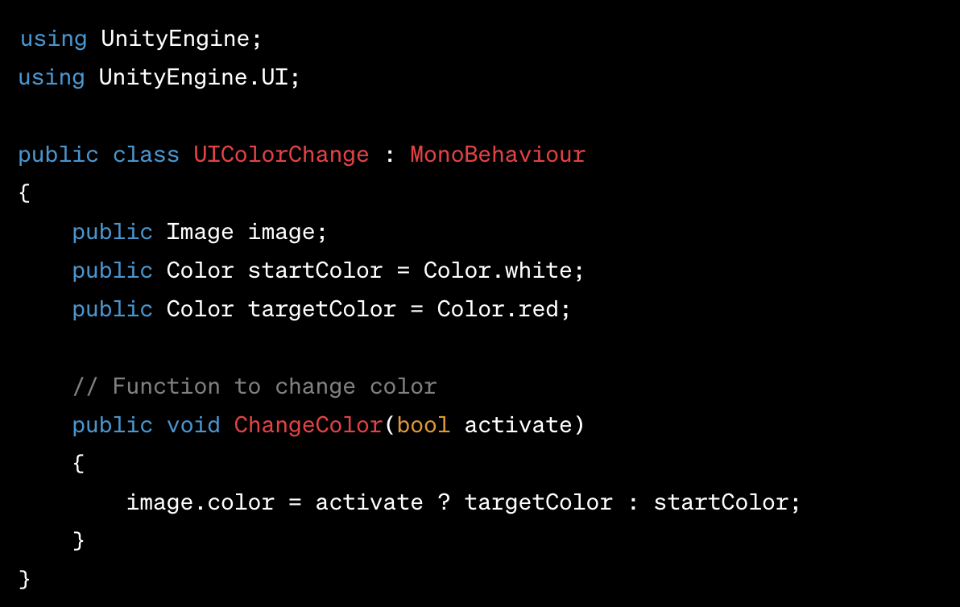
Interactive UI Animations
Example of dynamically changing the color of an image based on UI interaction
Setting up the UI:
Create a Canvas in your Unity scene.
Add an Image UI element to the Canvas.
Script for Dynamic Color Change:
Attach Script and Setup:
Attach the UIColorChange script to a GameObject.
Assign the Image UI element to the script's image variable in the Inspector.
Create a UI Button or Toggle UI element.
UI Interaction Setup:
Add an onClick event to the UI Button or Toggle.
Link the ChangeColor function of the UIColorChange script to the onClick event.

Slide 13
Animation Events
Animation events in Unity serve as markers within an animation clip's timeline that trigger scripted functions or actions at specific points during playback. They allow you to tie in custom C# scripts with animations, enabling more dynamic and interactive content.
By utilizing animation events in conjunction with C# scripts, developers can create intricate and responsive interactions, enabling animations to drive game mechanics, trigger sound effects, spawn objects, or initiate any desired action within a Unity project.
Notes:
Slide 6,7,8,9 nói qua về các màn hình (windows) khi làm việc với animation

Slide 14
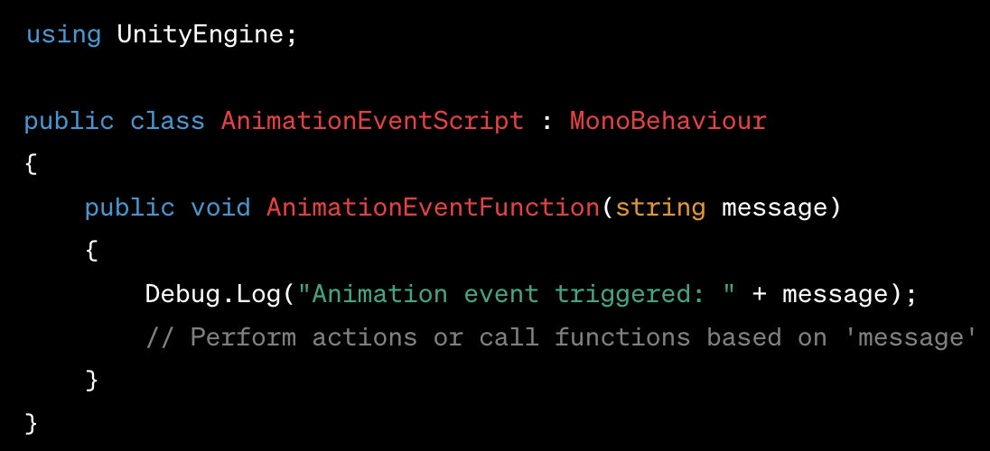
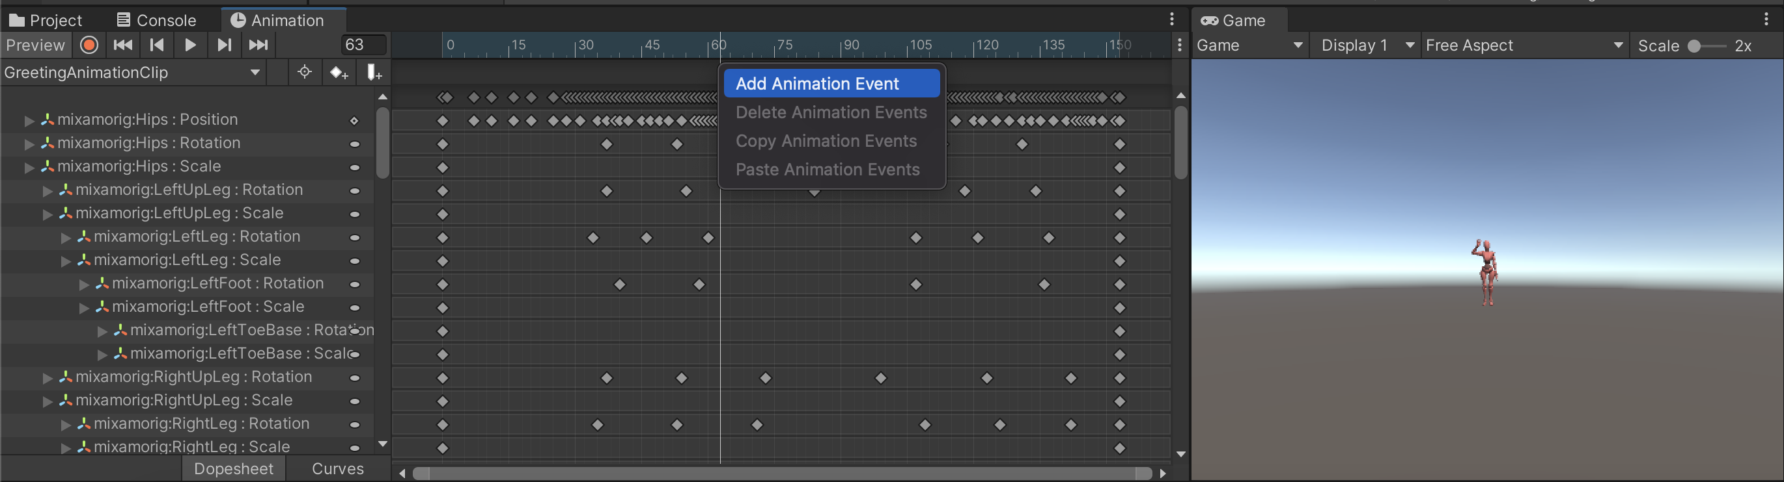
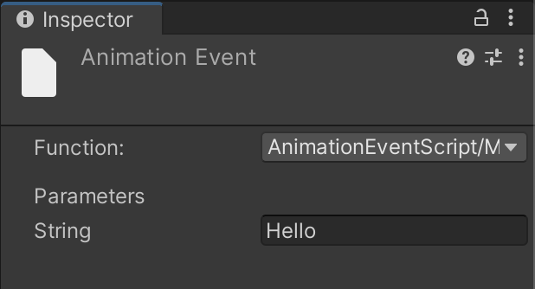
Animation Events
Working with animation events and C# scripts
Setting Events: In the Animation window, you can add events at precise frames in an animation clip.
Event Parameters: Each event can contain a function name to call and optionally pass parameters.
Timing Precision: Events help synchronize game logic or scripted actions precisely within an animation sequence.

Slide 15
Scripting Physics-Based Animations
Physics-based animations in Unity involve leveraging the physics engine to animate objects or characters realistically based on dynamic forces and interactions. Combining this with C# scripting allows for more control and customization over these physics-driven animations.
Physics-Based Animations Overview:
Realistic Motion: These animations simulate physical properties like gravity, collisions, and forces to generate lifelike movements.
Dynamic Interactions: Objects respond to external forces, environmental elements, or user input.
Natural Dynamics: Physics-based animations mimic real-world behavior, allowing for more authentic and organic movements.
Notes:
Slide 6,7,8,9 nói qua về các màn hình (windows) khi làm việc với animation

Slide 16
Scripting Physics-Based Animations
Using C# Scripts
Scripting Control: C# scripts can enhance or modify the behavior of physics-based animations.
Controlling Forces: You can use scripts to apply forces, adjust gravity, or create custom interactions between objects.
Triggering Actions: Scripts can respond to physics events (collisions, triggers) and change animation behavior accordingly.
Modifying Animation Properties: Dynamically adjust animation properties based on gameplay conditions using scripts.

Slide 17
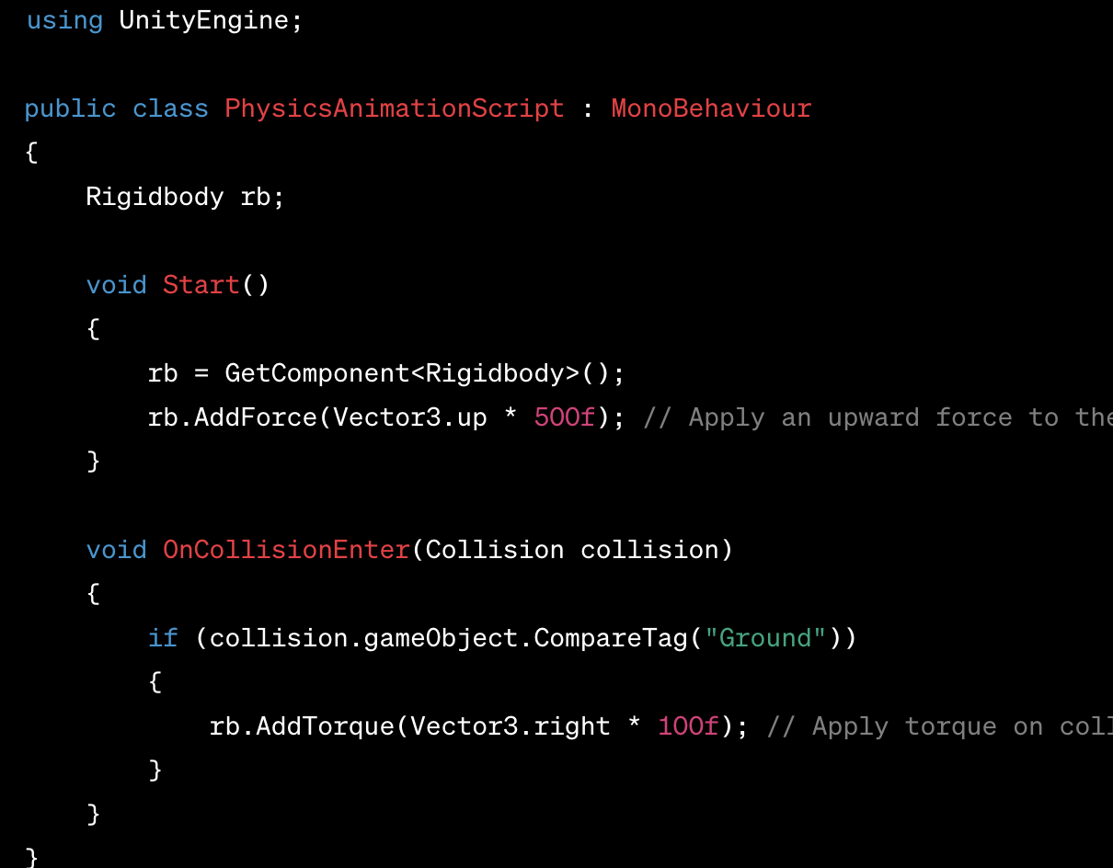
Scripting Physics-Based Animations
Using C# Scripts
Attach Script: Attach a C# script to GameObjects with Rigidbody components.
Implement Physics Logic: Use the script to apply forces, torque, or manipulate physics properties.
Interact with Animations: Combine physics-based interactions with animations to create dynamic and responsive character or object movements.

Slide 18
Scripting Physics-Based Animations
By incorporating C# scripting with physics-based animations in Unity, developers can create dynamic, interactive, and more lifelike simulations, providing engaging experiences for games or simulations.

Slide 19
Coding Exercise: Animation Scripting and Interactions
To understand Animation Scripting, let's work on an Animation Event exercise.
Perform the task of logging a debug message "Hello World!" when the Xbot from Mixamo raises its hand to greet.
Download the “Standing Greeting” animation from Mixamo.
Create a scene, add the Xbot character model to the scene, and add the Greeting animation to the character similar to the previous exercise.
As Mixamo's Animation is read-only, duplicate the Animation Clip and create a reference for the model.
In the Animation window, at frame 60, select Add Animation Event.
Create a C# script 'AnimationEventScript' with a function 'AnimationEventFunction' to log a debug message using the function's parameter.
In the Animation Event, reference the created function.
8: Unity Technologies, Unity Manual, 2023
Notes:
Students need to follow the next slide's instructions to practice with Unity.
Practice Resources sharing:
https://drive.google.com/drive/folders/1eXu20cX1o-5uMFuSeHGxRS5AkhDZJTOP?usp=sharing
For lecturer: open file in: ./LO.3-Animations-and-Physics/Lecturer-Guide/3.2_Animation-Scripting-and-Interactions.mp4
And user Assets file in ./LO.3-Animations-and-Physics/Lecturer-Guide/Assets/3.2_Animation-Scripting-and-Interactions/*
To create the final project.

Slide 20
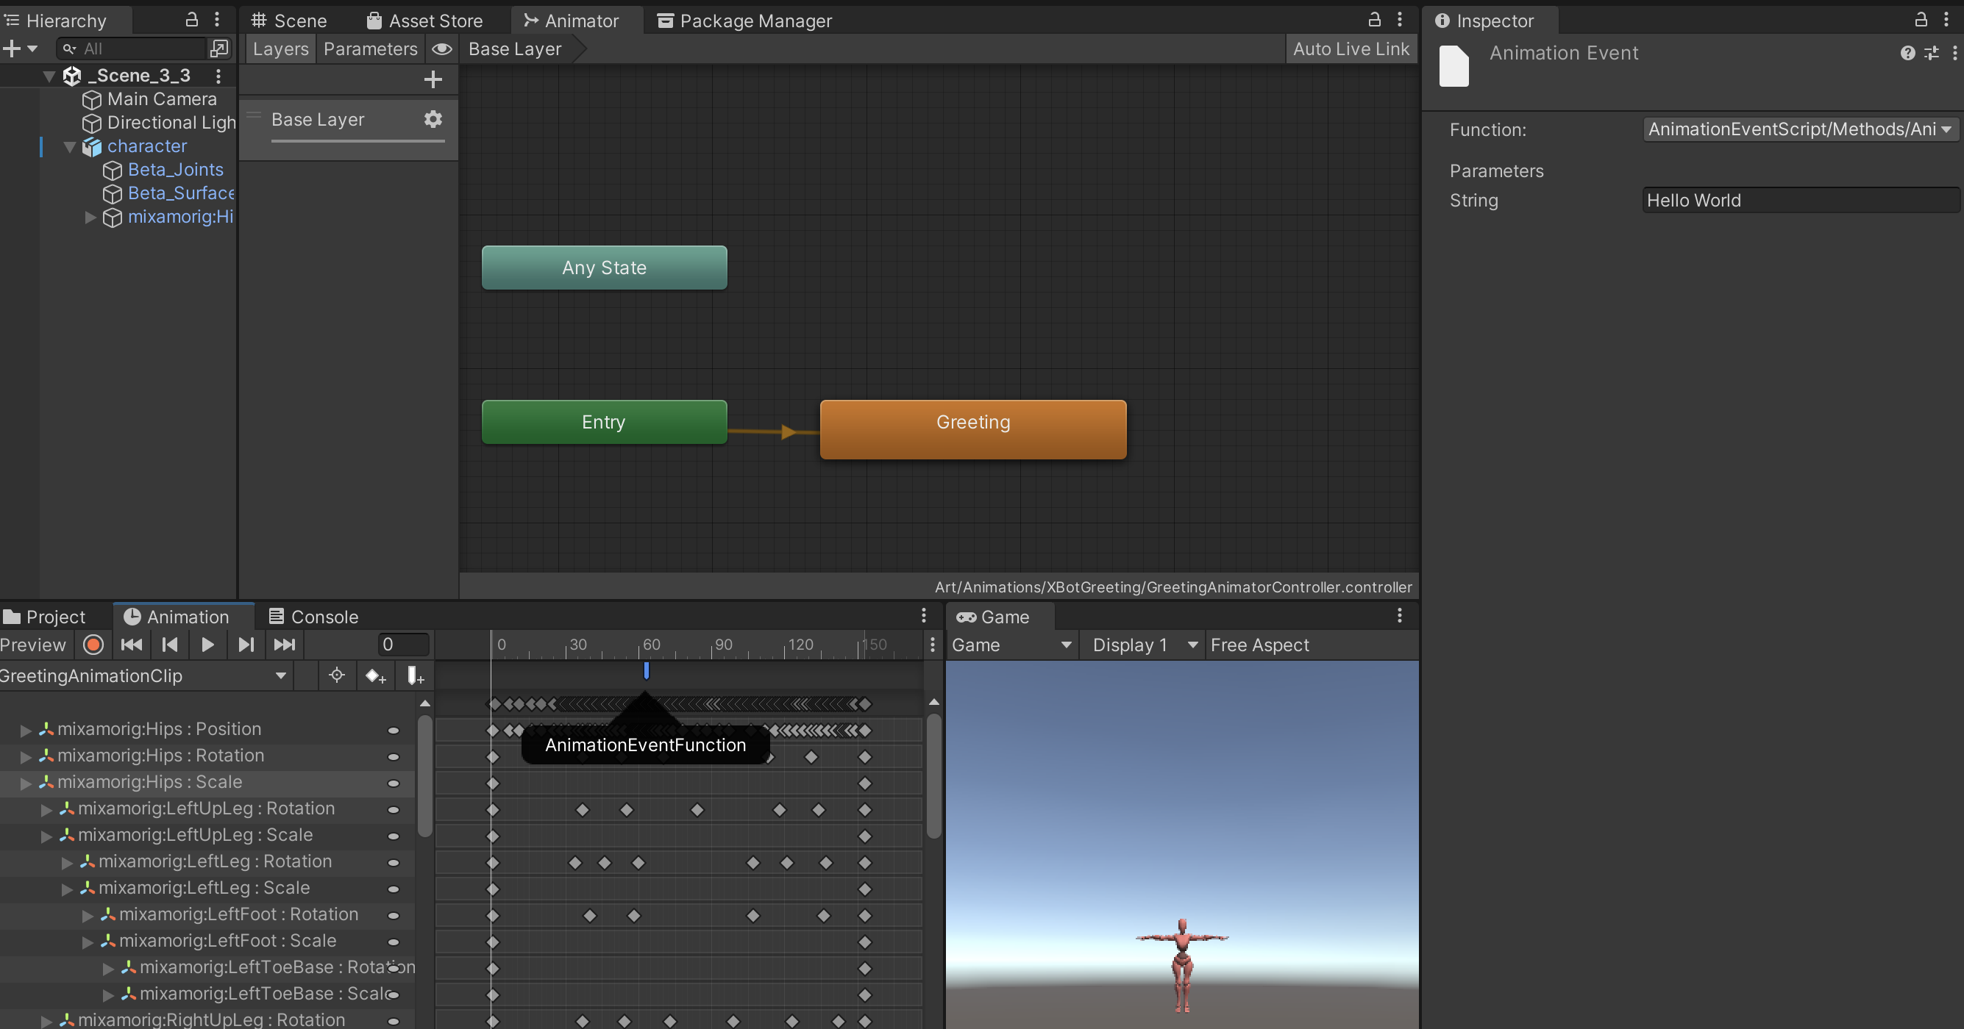
Coding Exercise: Greeting Animation

Slide 21
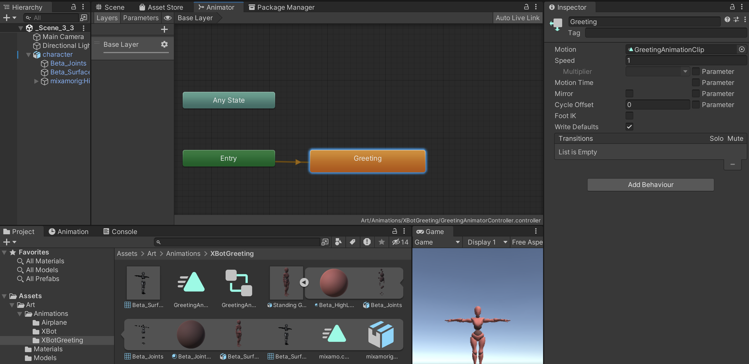
Coding Exercise: Greeting Animation
3. As Mixamo's Animation is read-only, duplicate the Animation Clip and create a reference for the model
duplicate

Slide 22
Advanced Topics: Blend Trees and Animation Layers
Blend Trees and Animation Layers are crucial components in Unity's animation system, enabling sophisticated control over character animations.
Blend Trees:
Purpose: Blend Trees allow the smooth transition between different animations based on parameters.
Functionality: They interpolate between animations based on varying parameters like speed, direction, or any other custom parameter.
Usage: Ideal for handling complex animations, such as transitioning between walking and running based on character speed.

Slide 23
Advanced Topics: Blend Trees and Animation Layers
Animation Layers:
Purpose: Animation Layers enable the overlay of multiple animations simultaneously.
Functionality: Layers stack animations on top of each other, allowing independent control over specific body parts or aspects like facial expressions, upper/lower body movements, etc.
Usage: Useful for creating intricate animations where various body parts have different behaviors simultaneously, like idle animations while walking, or upper body gestures while running.

Slide 24
Conclusion and Next Steps
Explored Unity's Animation System integration, demonstrating practical application and script-based control of animation clips.
Delved into the specifics of scripting animation transitions, showcasing seamless transitions based on user input or triggers.
Introduced scripting for interactive UI animations, showcasing examples of dynamic and responsive UI behaviors.
Explored animation events and their role in triggering scripted actions, demonstrated through interactive sequence examples.

